Slide 1
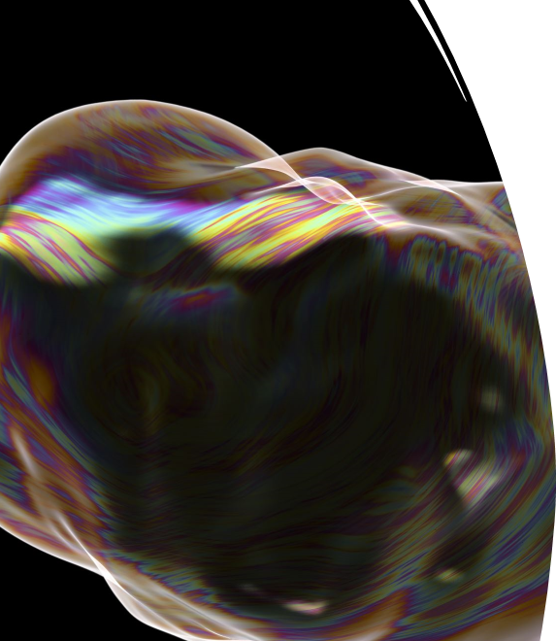
Generating Images with Flux using ComfyUI

Slide 2
Workshop Agenda
Introduction to Flux and ComfyUI
Setting Flux Schnell environment in Google Colab
WorkFlow for Flux Schnell K sampler in Python
Prompt Examples
ComfyUI Image Generation Process
ComfyUI Setup and Configuration with Flux
Building a Basic Workflow from Scratch
Prompt Examples
Wrap-Up and Q&A

Slide 3
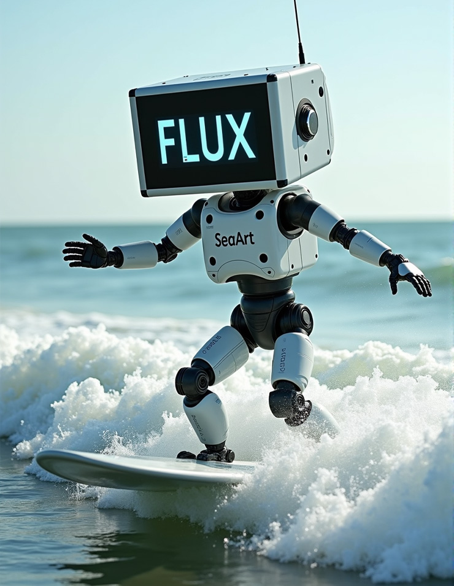
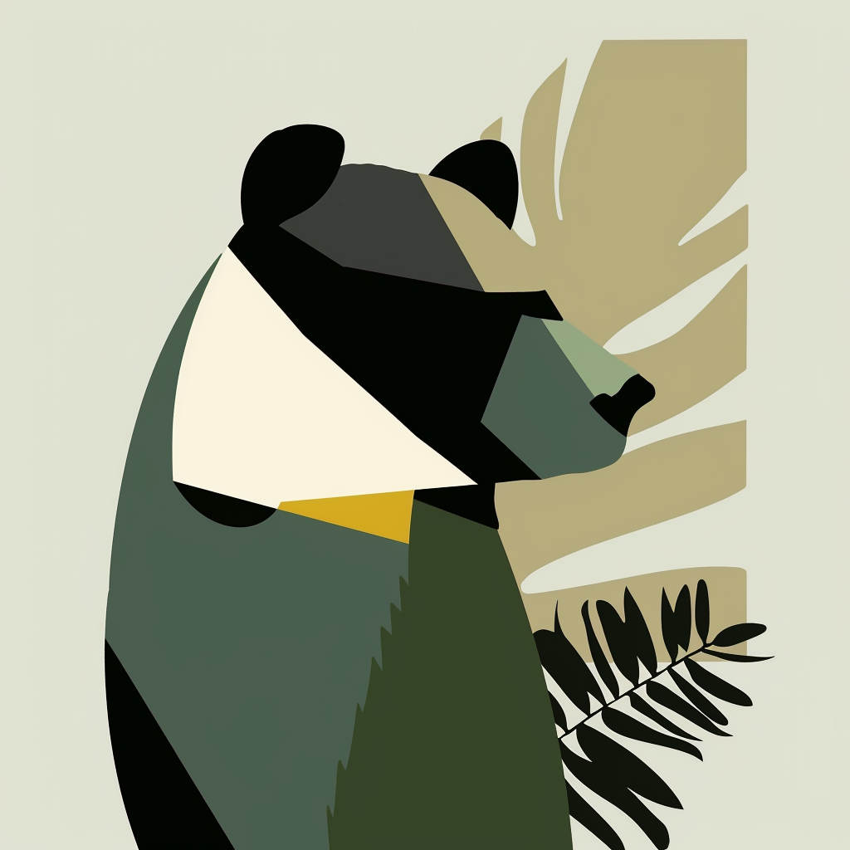
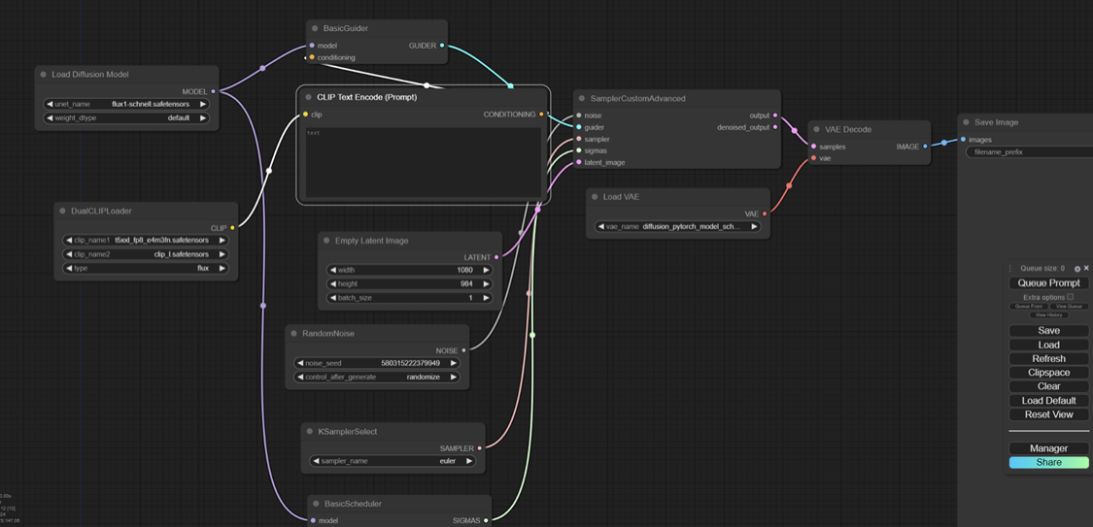

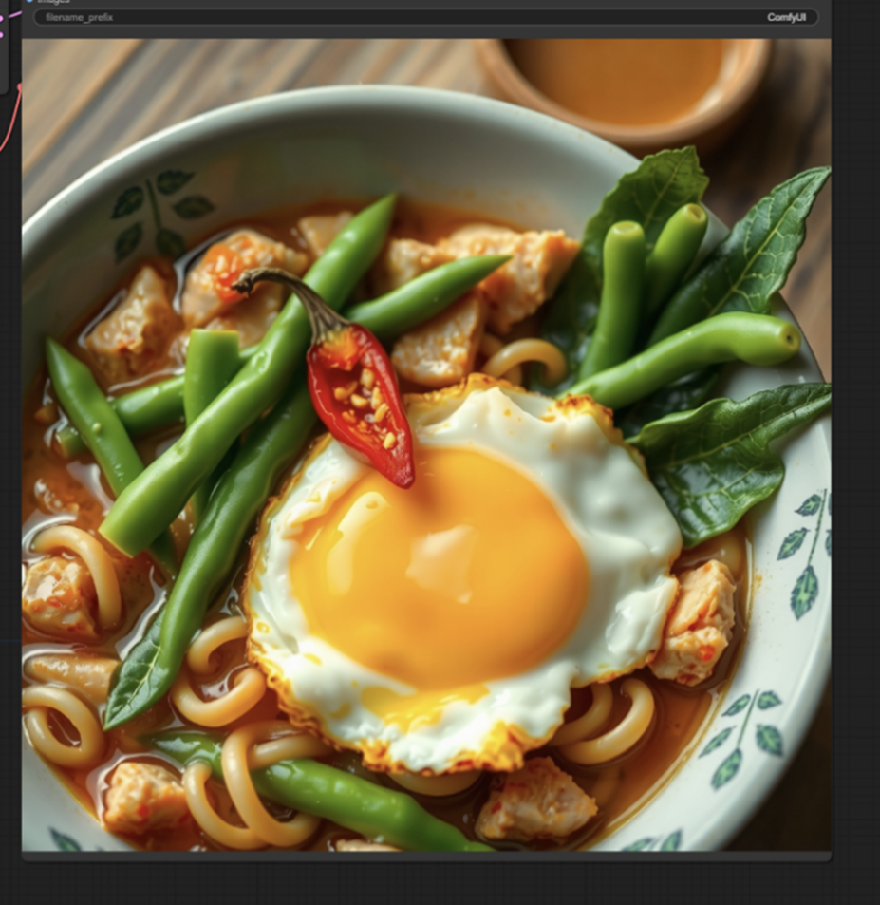
Flux AI
FLUX AI leverages deep learning algorithms to understand prompts (input text) and generate corresponding
visuals.
Flux Unleashed: Unlocking Creative Potential
Comfy UI
ComfyUI serves as a bridge between the user and the complex models running in the background, providing a
simple, graphical interface to work with FLUX AI.
A fast track to understanding and using Flux for seamless creativity.
Flux API
FLUX offers deep customization and integration with APII capabilities for developers, while Midjourney focuses on user-friendly, quick image generation with minimal setup.

Slide 4
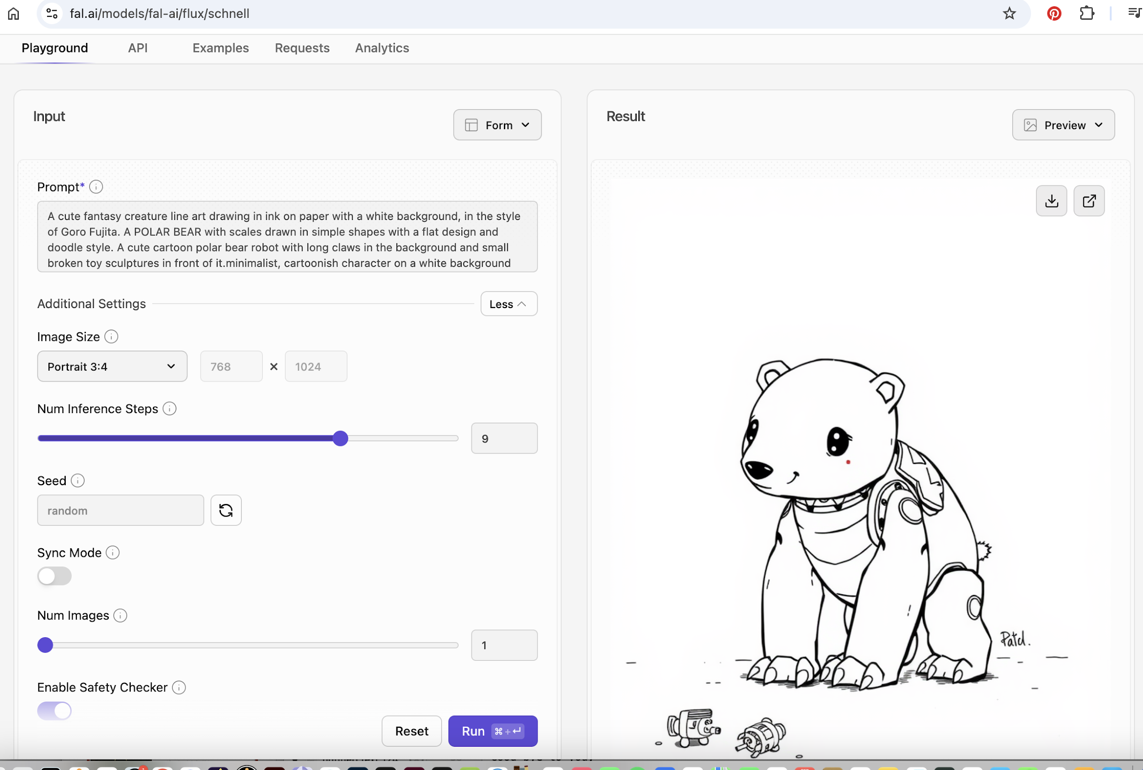
Flux website

Slide 5

Welcome to the world of AI-powered creativity! This guide is designed to help you navigate the exciting realm of image generation using FLUX Schnell AI, all within the flexible and accessible environment of Google Colab.

Slide 6
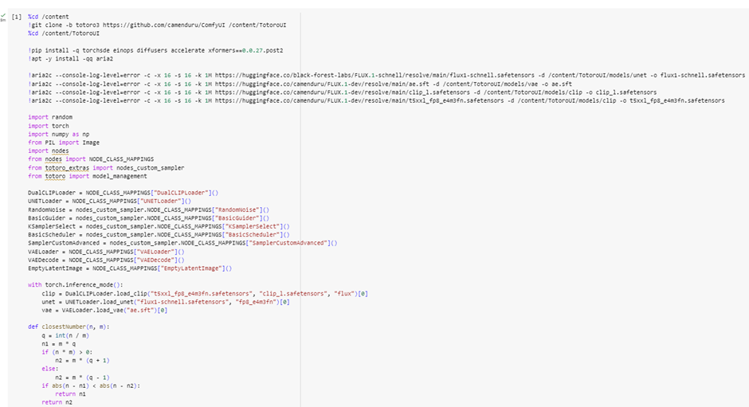
SettingSe
Setting Flux Schnell environment in Google Colab.
:

Slide 7
WorkFlow for Flux Schnell K sampler in Python
Import Libraries: The necessary libraries and modules are imported. Ensure you have these dependencies installed.
Define Parameters:
positive_prompt: A textual description that guides the image generation process.
width and height: Dimensions of the generated image. Must be multiples of 16.
seed: A number used for random noise generation. A seed of 0 will use a random value.
steps: Number of sampling steps, influencing the refinement of the generated image.
sampler_name: Specifies the sampling algorithm. Change this value to use different sampling methods.
scheduler: Defines how sigma values are handled during sampling.
Function Definitions:
generate_latent_image(): Generates a latent image based on the given parameters and prompt.
save_image(): Saves the decoded image to a specified path and returns the image object.
Image Generation Process:
Generate Latent Image: Uses the defined parameters and prompt to create a latent representation of the image.
Clear Memory Cache: Optimizes performance by freeing up memory.
Decode and Save Image: Converts the latent image to a human-readable format, saves it, and optionally displays it.
Usage Instructions
Setup: Ensure you have all the required libraries and modules installed.
Configuration: Adjust the parameters as needed for your specific use case.
Execution: Run the script to generate and view the image based on the provided prompt.
Troubleshooting: Check for parameter validity and ensure all dependencies are correctly installed.

Slide 8
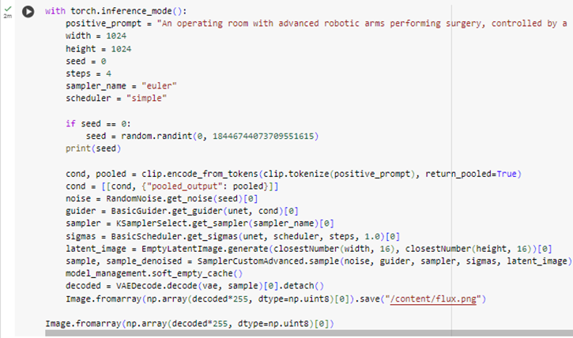
Flux Schnell Google Colab: https://colab.research.google.com/github/camenduru/flux-jupyter/blob/main/flux.1-schnell_jupyter.ipynb

Slide 9

Prompt: "A colossal dragon perched atop a mountain, overlooking an ancient kingdom, vibrant green and blue landscapes, towering castles with glowing orbs of light, misty skies, intricate dragon scales shimmering, detailed and epic fantasy art."
For the initial prompt, I have set the following parameters:
Width and Height: 1024 pixels
Seed: 0 (using a random seed for variability)
Steps: 4 (number of sampling iterations)
Sampler Name: Euler (sampling algorithm used)
Observation: Image took: 1 Minute and 14 seconds that is 19.64 seconds per iterations. The image quality is good but we need to improve the speed generation of the image.
[01:14<00:00, 19.64s/it]

Slide 10
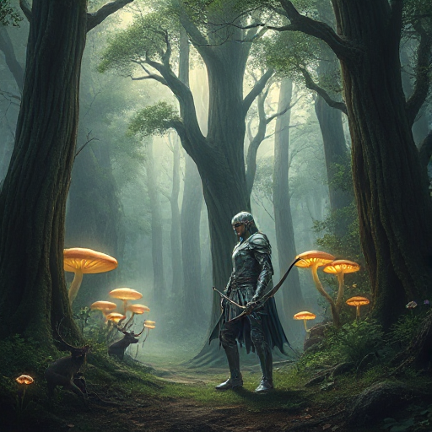
Prompt: "A serene portrayal of Goddess Lakshmi, seated on a blooming lotus, dressed in a gold and pink silk sari, showering coins from her hands, with an aura of divine light and vibrant lotus flowers surrounding her, traditional Indian architecture in the background – photorealistic, high detail, divine, soft golden lighting."
I have set the following parameters:
Width and Height: 512 pixels
Seed: 0 (using a random seed for variability)
Steps: 2 (number of sampling iterations)
Sampler Name: Euler (sampling algorithm used)
Observation: Image took: 8 seconds that is 4.41 seconds per iterations. The image quality is great and the speed escalated as we modified the sampler numbers but it has issues like number of hands. [00:08<00:00, 4.41s/it]

Slide 11
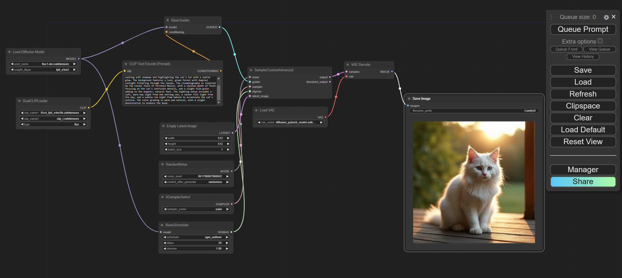
ComfyUI Image Generation Process
ComfyUI is a powerful tool for AI image generation. The process involves several key components working together to transform text prompts into unique visual creations. Let's explore the steps and elements involved in this fascinating process.
It is a visual interface for running models locally. (Download the Flux_Simple_WF2.json Workflow file from here.)

Slide 12
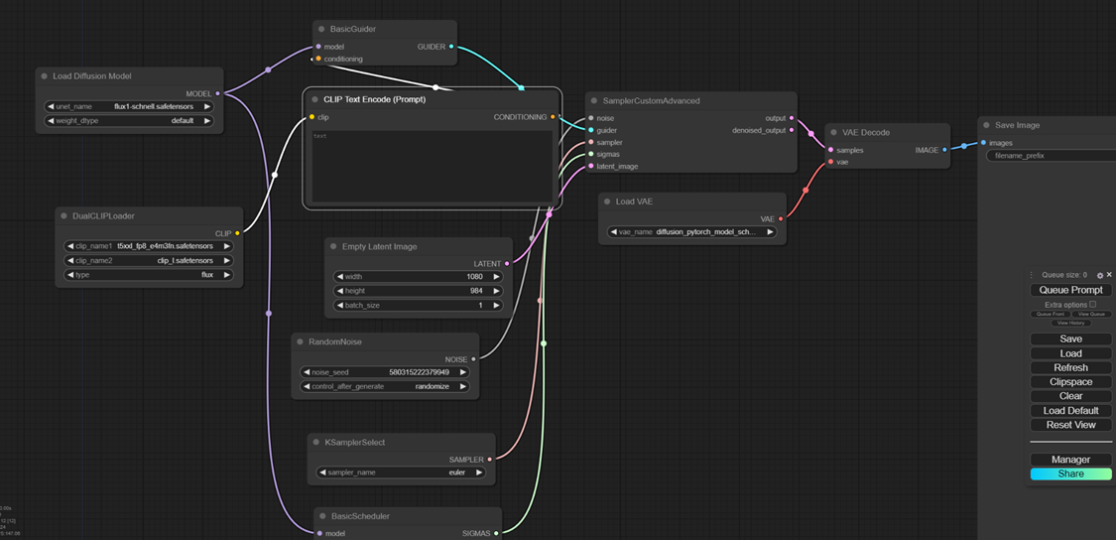
ComfyUI Setup and Configuration
System Requirements Verification
Confirm your system meets minimum requirements, especially VRAM
Downloading and Installing ComfyUI
Download and extract ComfyUI from the provided link. This interface simplifies FLUX AI interaction without coding.
Integrating FLUX AI with ComfyUI:
Download and place FLUX AI models (Dev and Schnell) into the appropriate ComfyUI folders (unet, clip, vae).
Workflow Setup for Image Generation
Download the pre-configured workflow for ComfyUI, which serves as a visual script for image generation
Launching ComfyUI
Launch ComfyUI using the appropriate batch file (CPU or GPU). Drag and drop the workflow to start image generation
Experimentation and Customization
ComfyUI’s user-friendly interface allows easy adjustments and real-time feedback.

Slide 13
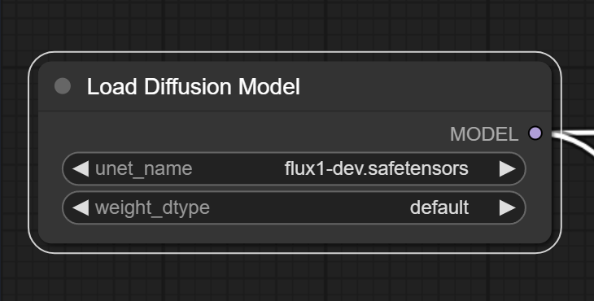
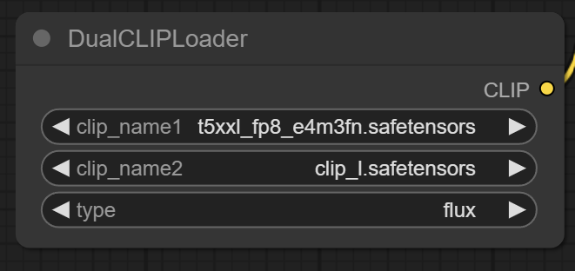
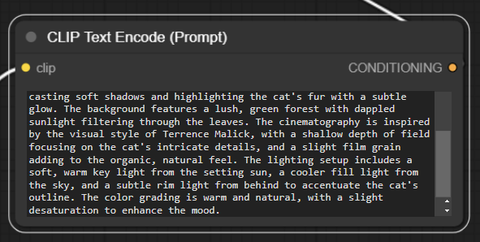
Core Components: Diffusion Model and CLIP
Load Diffusion Model
DualCLIPLoader
CLIP Text Encode (Prompt)
This is where the core image-generation model is loaded. It takes random noise and turns it into a meaningful image using your input text.
Loads two models that understand the connection between words and images, ensuring that the final image matches the text you provided.
This is where you describe what you want to see in the image. The text prompt guides the model on what to create.

Slide 14
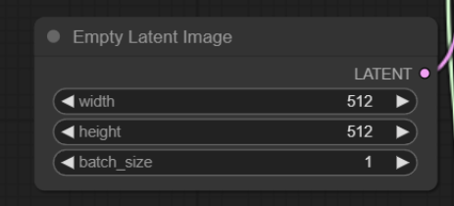
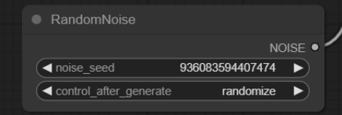
Setting the Stage: Image Canvas and Noise
1
Empty Latent Image
This sets up an empty canvas for the model to start working on. It defines the image's size and resolution.
2
RandomNoise
The image generation starts with random noise. This randomness ensures that every image is unique, even with the same prompt.

Slide 15
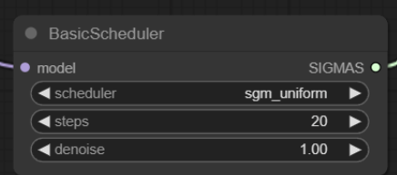
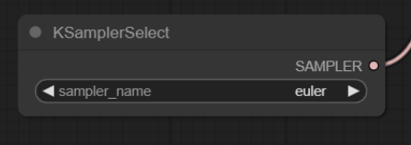
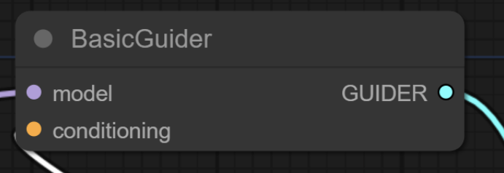
Guiding the Process: Sampling and Scheduling
KSamplerSelect
BasicGuider
Specifies how the model processes the noise into an image. This component chooses the method (like Euler) that balances speed and quality.
Guides the model using the text prompt to ensure that the final image matches the description.
BasicScheduler
Controls the pace and steps of removing the noise. It ensures that the noise reduction happens smoothly across the image.

Slide 16
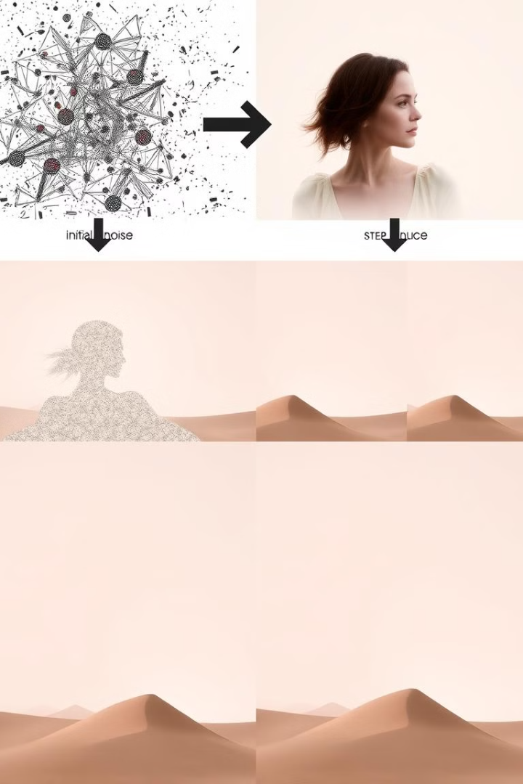


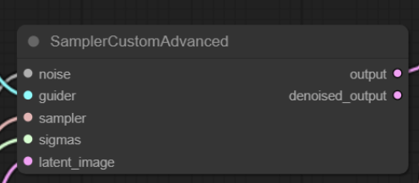
Refining the Image: Conditioning and Sampling
Conditioning
Combines all the factors like text, noise, and image settings to make sure that the instructions from the prompt are followed throughout the process.
SamplerCustomAdvanced
The core process that refines the noise into a final image, applying the guidance and settings from earlier components.

Slide 17
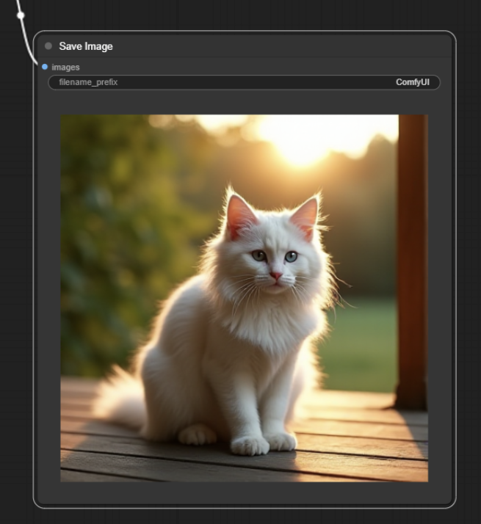
Finalizing and Saving the Result
1
Save Image
Saves the generated image with a filename, allowing you to keep and use the final result.
2
File Management
Ensures that your created images are properly stored and accessible for future use or editing.
3
Output Formats
Allows for saving in various image formats to suit different needs and applications.

Slide 18
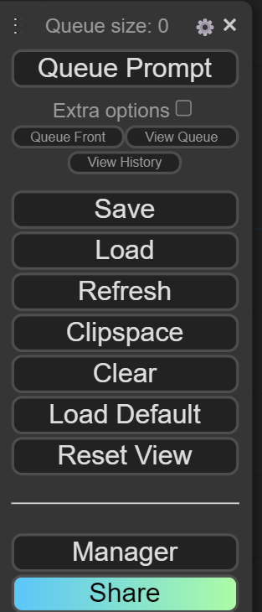
User Interface and Controls
Feature | Description
Queue Prompt | Adds the current prompt or workflow to the processing queue.
Queue Front | Moves the selected prompt to the front of the queue.
View Queue | Displays all pending prompts in the queue.
View History | Shows a history of previously processed prompts.
Save | Saves the current workflow setup for future use.
Load | Loads a previously saved workflow.
Refresh | Refreshes the interface or workflow settings.
Clipspace | Copies the current workflow to the clipboard.
Clear | Clears the current workspace of all nodes.
Load Default | Resets to the default node or workspace setup.
Reset View | Resets the workspace view to the default layout.
Manager | Opens the manager for nodes or workflows.
Share | Shares the current workflow or generated image.

Slide 19
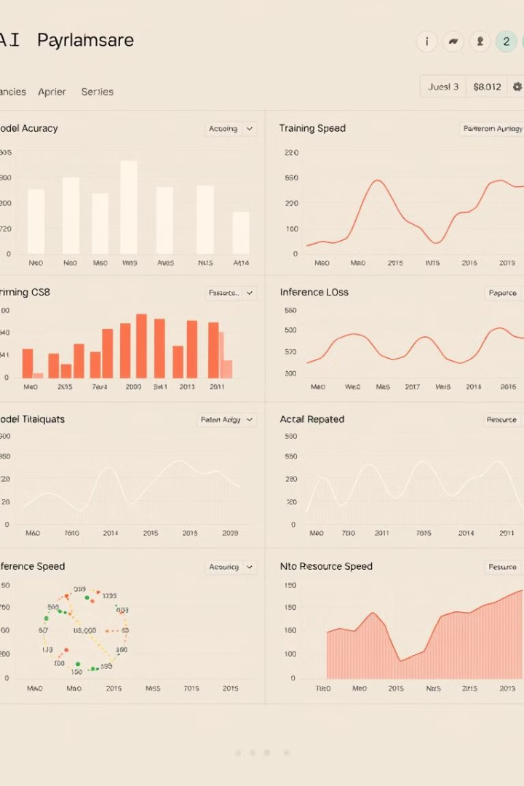



Performance Monitoring
Processing Time
Tracks the time taken for image generation (For e.g. The Cat Prompt took 24.5 mins to generate)
Node Usage
Displays the number of nodes used in the process (For e.g. 12 Nodes were used for this Workflow)
System Performance
Shows real-time information about the system's performance (Check task Manager for the CPU usage, Memory usage and GPU usage)

Slide 20
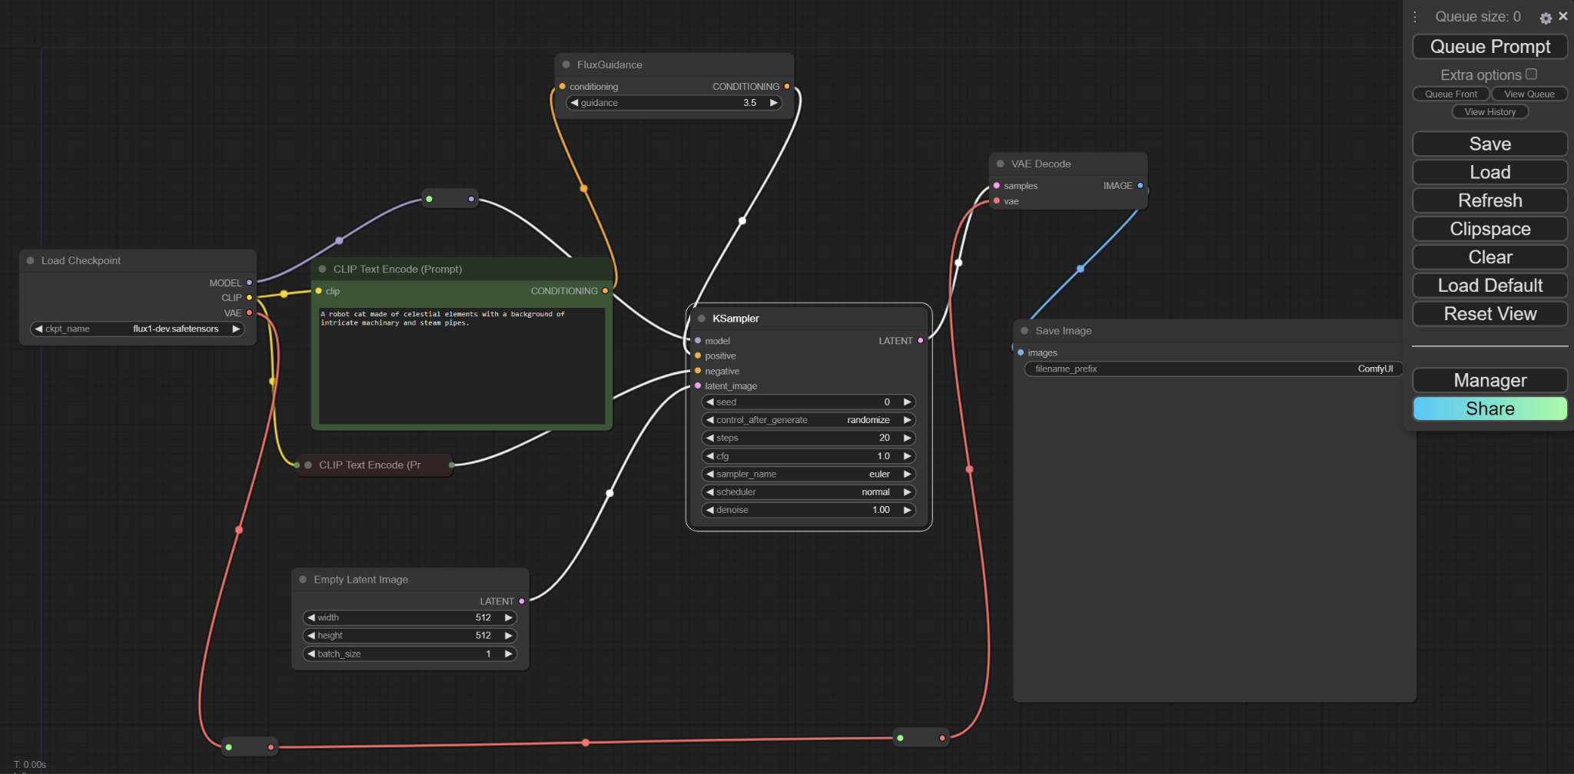
Building a Basic Workflow from Scratch
ComfyUI Setup: Start with a blank canvas in ComfyUI.
Load Checkpoint: Add the load checkpoint node for the Flux Dev model. Right Click🡪 Add Node🡪 Loaders 🡪 Load Checkpoint
Positive Prompt: Use the clip text encode node for positive prompts. Right Click🡪 Add Node🡪 Conditioning 🡪 Clip Text Encode (Prompt) 🡪 Make the color green to indicate positive prompt
K Sampler Node: Connect the Ksampler to generate images. Right Click🡪 Add Node🡪 Sampling 🡪 Ksampler
Image Sizing: For Image sizing we add the Empty Latent Image node Right Click🡪 Add Node🡪 Latent 🡪 Empty Latent Image Node
Model Download: Download and save Flux dev model checkpoint from Hugging Face. Save it in this directory: ComfyUI/models/checkpoints/ directory
VAE Decode Node: Double click to search for the VAE Decode node to process everything into an image. Connect the Load Checkpoint Vae output to the VAE Decode Node using reroute option.
Node Connections: Ensure all nodes are correctly connected for processing.
Connect the Model Output from the Load Checkpoint into Ksampler node
Drag the Clip into the Positive Prompt
Double click to search for the Flux Guidance node and connect it to the Positive prompt before connecting it to the Ksampler node.
IMP: Make sure to set CFG to 1.0 in the Ksampler Node.
Change the seed to 50 in the Ksampler Node and leave everything else to default.
You can play around with different samplers and Schedulers to generate different images.
Connect the Empty Latent Image to the Ksampler
Connect the Ksampler output to VAE Decode Node
Finally add a Save Image node to save the image
Download the Flux_Simple_WF.json Workflow file from here.

Slide 21
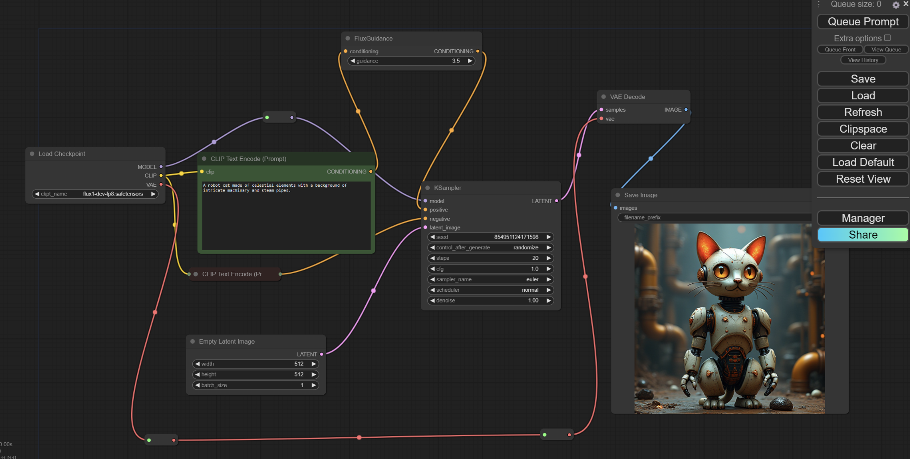

Building a Basic Workflow from Scratch
Negative Prompt: Create a negative prompt node (Red color) to connect to the Ksampler and the Load Checkpoint node. Since we’re not using Negative Prompt here, you can collapse the node.
Image Generation: Enter your prompt in your Positive Prompt node and queue prompt. “A robot cat made of celestial elements with a background of intricate machinary and steam pipes.” First image may take time, but subsequent generations are faster. This 512 x 512 Image took 28.5 minutes to generate
Download the Flux_Simple_WF.json Workflow file from here.

Slide 22
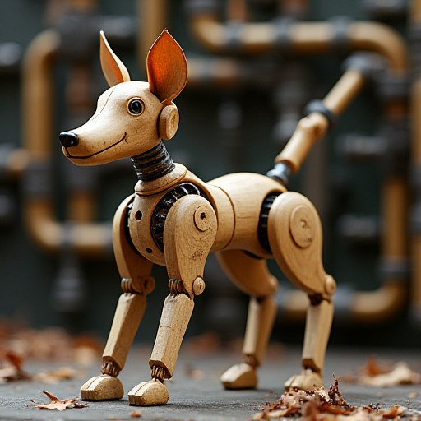
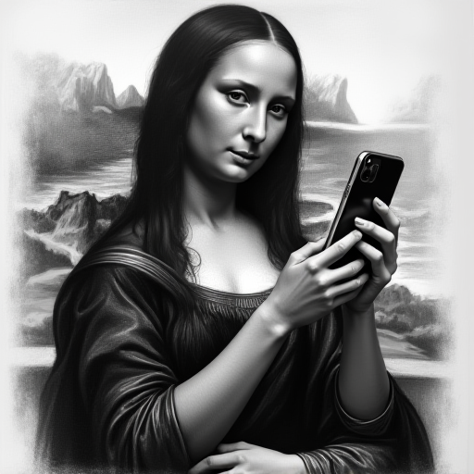
Building a Basic Workflow from Scratch
Prompt: “A robot dog made of wood and leaves with a background of intricate machinary and steam pipes.” Comment: This 512 x 512 Image took 27.1 minutes to generate.
Prompt: “A hyper-realistic charcoal drawing of Mona Lisa looking at an iPhone, on paper, deep blacks and expressive lines.” Comment: This 512 x 512 Image took 25.8 minutes to generate.

Slide 23

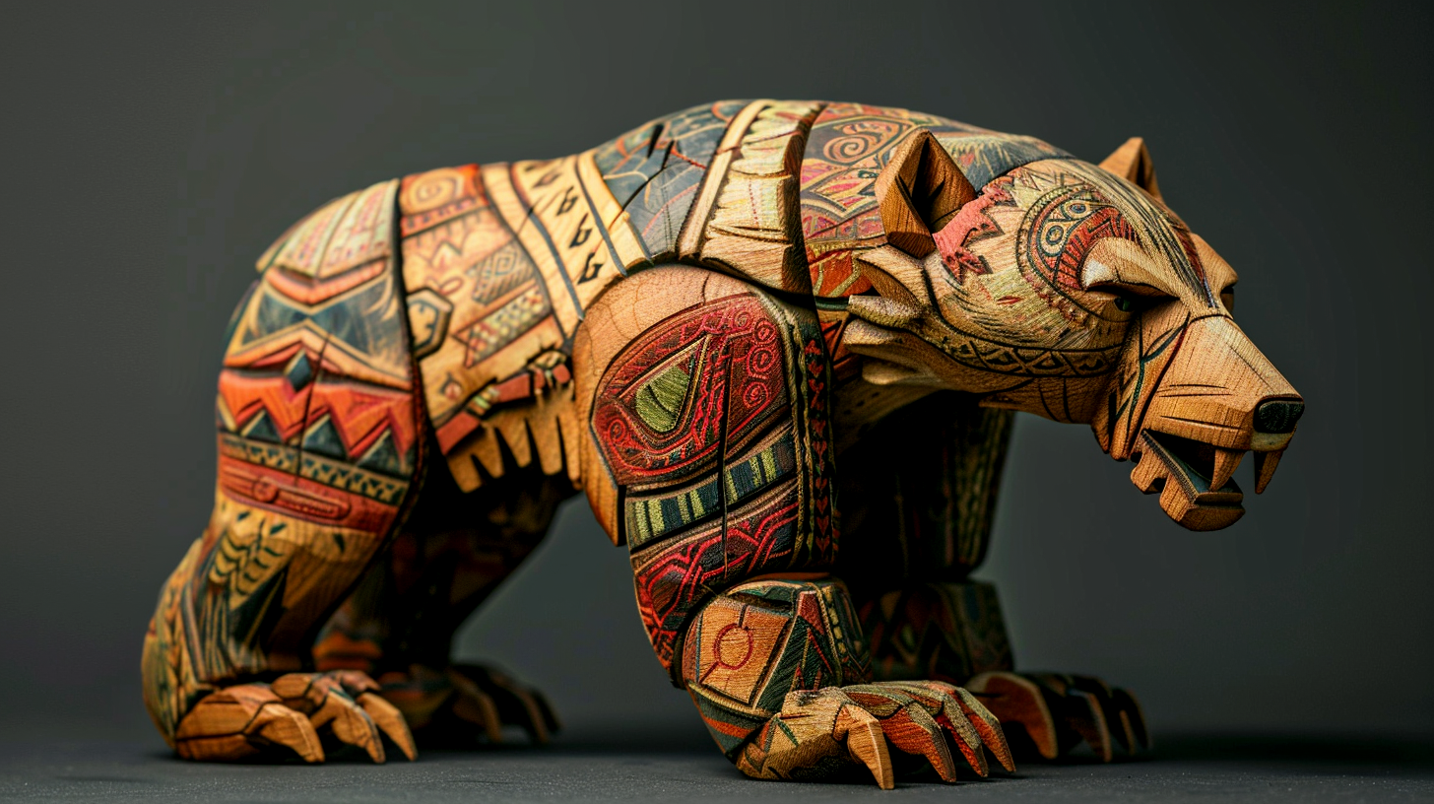
Q&A

